Slide 1
Valinor Public Limited
International Agro Holding
Investment Opportunity
December 2011

Slide 2
Disclaimer
Deutsche Bank AG, London Branch (“Deutsche Bank”) and Investohills Capital (“Investohills” and, together with Deutsche Bank, the “Banks”) are acting as financial advisers to Valars Management Limited (the “Shareholders”) in relation to a potential sale of all or a substantial part of their direct or indirect stake in the Company (as defined below) (the “Transaction”). The Banks have been authorised by the Shareholders to issue this document on their behalf in connection with the Transaction.
This document is provided for information purposes only and on the basis that each recipient of this document (a “Recipient”) and such Recipient’s directors, officers and employees keep it and the existence of the Transaction confidential. This document is only being made available to persons who have signed and returned a confidentiality agreement (each, a “Confidentiality Agreement”) and each Recipient agrees to keep this document, and any information made available to it in connection with the Transaction, confidential. Other than as permitted by the Confidentiality Agreement, neither this document nor any of its contents may be photocopied or reproduced, in whole or in part, or referred to, distributed to, disclosed to or communicated to, in whole or in part, any other person (which expression shall include a reference to a body corporate, association or partnership), or published in whole or in part for any purpose.
No person may rely on this document without the prior written consent of the Banks. Nothing in this document shall be taken as constituting the giving of investment advice and this document is not intended to provide, and must not be taken as, the basis of any investment decision regarding the Transaction. This document does not constitute an offer or invitation for the sale or purchase of, or the solicitation of an offer to acquire, the securities, businesses and/or assets of Valinor Public Limited (the “Company”) or any other person, whether in relation to the Transaction or otherwise. Neither this document nor anything contained herein shall, nor shall any other oral or written information made available, other than a definitive and binding sale and purchase agreement or other similar such agreement, form the basis of any contract or commitment whatsoever. This document should not be considered as a recommendation on the part of any of the Shareholders or the Banks.
All information, assumptions, data and results contained in this document, whether express or implied, are based on information (i) provided by or on behalf of the Company to each Bank and/or any other member of each Bank’s Group (which expression shall mean with regard to each Bank, such Bank, together its affiliates, associated companies, subsidiary undertakings and branches) or (ii) which was publicly available (together, “Information”). The accuracy and completeness of such Information has not been independently verified by the Company, the Shareholders, the Banks, any member of any Bank’s Group, any of their respective officers, directors, employees, representatives, advisers and/or agents (together, “Relevant Persons”) or any other person. In preparing this document, each Bank has assumed and relied upon the accuracy and completeness of all Information. None of the Relevant Persons (i) makes or will make any representation or warranty, expressed or implied, in relation to the accuracy, reliability, adequacy or completeness of the Information, this document or any of its contents or the results that can be derived from this document or any other written information or oral information provided in connection therewith or any data that any of them generates; (ii) accepts or will accept any responsibility, liability or obligation (whether in contract, tort or otherwise) in relation to the Information, this document or its contents or any other written information or oral information provided in connection therewith or any data that any of them generates, except to the extent that such responsibility, liability or obligation cannot be excluded by law; (iii) accepts or will accept any responsibility or liability to any other person in relation to the distribution or possession of this document in any jurisdiction, except to the extent that such responsibility or liability cannot be excluded by law; (iv) assumes or will assume any responsibility or liability to any potential purchaser or any other person for any loss or damage of any kind whatsoever arising as a result of such purchaser’s or such other person’s use or misuse of this document or any of its contents, including, without limitation, any direct, indirect or consequential loss or damage suffered by any person as a result of relying on the accuracy of any information in this document or any errors or omissions in this document; (v) accepts or will accept any responsibility, duty of care or liability for providing the Recipient with access to any additional information, updating this document or any of its contents or for correcting or notifying any person of any inaccuracy in this document or any of its contents or any other written information or oral information provided in connection therewith or any data that any of them generates which may become apparent; or (vi) are under any obligation to consider or accept any offer, irrespective of whether such offer is the only offer or one of a number of offers representing the highest price. No audit of this document has been undertaken by an independent third party. Nothing herein is intended to exclude any liability for, or remedy in respect of, fraudulent misrepresentation.
This document does not purport to contain all the information that may be required to evaluate all factors that would be relevant in relation to the Transaction. Any Recipient interested in purchasing securities, businesses and/or assets of the Company and/or any other person is recommended to seek its own independent legal and financial advice. Any decision as to whether or not to purchase the Company’s and/or any other person’s securities, businesses and/or assets should be taken solely by the Recipient. Before entering into such transaction(s), the Recipient should take steps to ensure that it fully understands such transaction(s) and has made an independent assessment of the appropriateness of such transaction(s) in the light of its own objectives and circumstances, including the possible risks and benefits of entering into such transaction(s). No contact shall be made with the Company, the Shareholders, or any of their respective directors, officers or employees, either directly or indirectly, with respect to any of the information contained in this document or with respect to any possible transaction involving the Company, and any enquiries must be channelled through the Banks. The views expressed in this document are subject to change based upon a number of factors, including, without limitation, market conditions and the Company’s business and prospects, as well as any change to the Banks’ assumptions.
Each Bank is acting, together with the other Bank, as an exclusive financial adviser to the Shareholders in relation to the Transaction, will not regard any other person (whether a Recipient or not) as a client in relation to the Transaction and will not be responsible to anyone other than the Shareholders for providing the protections afforded to clients of such Bank nor for providing advice to any such other person. Without prejudice to liability for fraud, each member of any Bank’s Group disclaims any liability to any such other person in connection with the Transaction.
This document is only being made available to interested parties on the basis that: (A) if they are UK persons, they are persons falling within Articles 19 or 49 of the Financial Services and Markets Act 2000 (Financial Promotion) Order 2005; (B) if they are US persons (as defined in Regulation S under the Securities Act of 1933, as amended (the ‘Securities Act’), they are ‘accredited investors’ as defined under Rule 501(a) under the Securities Act who represent that they are participating in the Transaction for their own account for investment purposes only and not with a view to resale, who are willing and able to conduct an independent investigation of the risks of participation in the Transaction and who will be required to represent that they are participating in the Transaction for investment purposes; or (C) they are outside the United Kingdom, are not US persons (as defined in Regulation S) and are eligible under local law to receive this document (all such persons collectively being referred to as ‘Intended Recipients’). Recipients in jurisdictions outside the UK who are not US persons should inform themselves about and observe any applicable legal requirements. By accepting this document you represent and warrant that you are an Intended Recipient. This document must not be acted on or relied upon and should be returned to the Banks by persons who are not Intended Recipients. Any investment or investment activity to which this communication relates is available only to Intended Recipients and will be engaged in only with Intended Recipients.
Forward-looking statements - No representation or warranty is given as to the completeness or accuracy of any forward-looking statements contained in this document. These statements include statements regarding, among other things, the Company's results of operation, financial condition, liquidity, prospects, growth, strategies and the industry in which Company operates. The use of the words ‘expects’, ‘intends’, ‘anticipates’, ‘estimates’, ‘may’, ‘forecast’, ‘objective’, ‘plan’ or ‘target’, and other similar expressions are intended to identify forward-looking statements. These forward-looking statements are not guarantees of future performance and are subject to a number of risks and uncertainties. Any statement, estimate and projection included in this document with respect to anticipated future performance may not prove to be correct and should not be relied upon as a promise or representation as to future performance. Important factors that could cause actual results to differ materially from those discussed in such forward-looking statements include but are not limited to: adverse trends in the general economy, business conditions or interest rates; the Company’s ability to anticipate customer requirements; the reputation of the Company and its trading names, together with the success of the Company's marketing and promotional programmes; the ability to recruit, train and retain staff; and the suitability and reliability of the Company’s systems and procedures, including its information technology. With respect to any financial projections forming part of the Information, each Bank has assumed that they were prepared on bases reflecting the best estimates and judgements of the future financial performance of the Company available at the time of their preparation. This document is necessarily based on economic, market and other conditions as in effect on its date, and the Information made available to the Banks as of the date hereof.
1

Slide 3
Strictly Confidential
    Dear Sir or Madam,
    We would like to discuss with you an opportunity to acquire Valinor Public Limited (“Valinor” or “the Company”), a leading agriculture producer in the CIS (“the Transaction”).
    Valinor is one of the largest and most technologically advanced agriculture businesses in the CIS with 360,000 hectares of land
    under control in Russia and Ukraine. It is focused on production of cereals, oilseeds and other crops with 1,315 ths. tonnes of crops harvested in 2011.
    The Company has engaged Deutsche Bank and Investohills Capital as its financial advisors in connection with the proposed Transaction. The Company’s shareholders intend to sell up to 100% in Valinor.
    Attached you will find a brief overview of the Company and the highlights of the Russian and Ukraine agri markets.
    Upon receipt of indication of your interest we will sign NDA and send information memorandum.

Slide 4
Valinor at a Glance
    One of the largest agricultural businesses in the CIS both in terms of cultivated land area and crops harvested
    Focus on crop production with operations in Russia and Ukraine
    Land bank – 358 ths. hectares of land, including 47 ths. hectares in ownership, in highly fertile regions, including:
      235 ths. hectares in Russia and
      123 ths. hectares in Ukraine
    Production: cereals (wheat, barley and corn), oilseeds (sunflower and rapeseeds), sugar beet and others with total volume of
    1,315 ths. tonnes in 2011E
    Agricultural machinery fleet of 2,013 units and transportation fleet of 4,008 trucks
    Total storage capacity of 1,277 ths. tonnes, including 564 ths. tonnes of silos capacities and 713 ths. tonnes of on-farm storage capacity
    More than 6,200 full-time employees
    85% owned by management
Valinor’s land bank location in Russia and Ukraine
Russia
Sumy
Region
Ukraine
Cherkassy Region
Poltava
Region
Vinnitsa
Region
Kherson
Region
Rostov Region
Nikolaev
Region
Stavropol Region
Krasnodar Region
- Regions
- Land
Key financial indicators
Revenue from crops sales (US$) in 2011E, %
Note: (1) : EBITDA is not a measure of performance under IFRS. The Company defines EBITDA as profit or loss for the year before: (i) income tax expense/benefit;
(ii) gain realized from acquisitions of subsidiaries; (iii) non-operating foreign exchange gains/losses, net; (iv) finance income; (v) finance costs, net; (vi) impairment loss on goodwill and
property, plant and equipment; (vii) depreciation and amortization; and (viii) loss on disposals. In 2011 EBITDA is also adjusted for IPO expenses in the amount of US$4.5mn
Source: IFRS financial statements, or derived from IFRS financial statements, Company data
3

Slide 5
Key Investment Highlights
Pure crop producer model
    Attractive business model focused on crop production, rather than processing or trading
    Approximately 90% of revenue is attributable to crop production (2011E)
High quality land bank
    Land bank is located in selected regions of Russia and Ukraine with highly advantageous climate and soil conditions for crop production, which are less prone to weather related damage
    Land bank is composed of separate large clusters, giving a natural hedge against adverse weather conditions and significant efficiencies in cultivating and harvesting
    Proximity of land clusters to key transportation routes and sea ports
Optimal product mix
    Crop mix composed of basic products for which there is high demand and liquidity
    Crop rotation policy developed in a way that maximizes both productivity and profit potential
High efficiency of operations
    Advanced farming techniques and modern machinery support high efficiency and crop yields
    Significant investments made to maximize land utilization, harvest yields and cost efficiency
Advantageous logistical infrastructure and storage capacity
    Self-sufficiency in silos and on-farm granaries allows crops to be stored during the year and be sold during periods of higher prices
    Strong logistics platform based on a fleet of owned trucks
Benefits from scale
    The Group’s focus on production and large scale of operations allows it to benefit significantly from economies of scale in (i) land acquisition/lease terms, (ii) purchasing power in raw materials (seeds, fertilizers) and machinery, (iii) production, (iv) logistics, and (v) crop pricing
Strong management
    Highly experienced management team with long track record in agriculture sector and unique knowledge of the business since its inception
Highly attractive market fundamentals
    Surging global demand and prices for grain and oilseeds and limited potential for supply growth promotes price increase trend and supports long-term profitability of the business model
4

Slide 6
Clear Focus on Crop Production
Valinor business model
    Land as investment
Land management
Crop production
Infrastruc-ture and logistics
Sales platform
    Processing
    Not Valinor’s strategic focus:
      87% of land portfolio leased
      46,917 ha of land owned
    Land search/screening
    Land bank expansion
    Land integration
    Lease rights management
    Crop planning
    Cultivation and harvesting
    Supplementary activities
    Production of seeds
    In-land silos storages
    On-farm storages
    Transportation fleet
    Domestic sales
    International sales
    Not Valinor’s strategic focus:
      90% of revenue from crop production
      4% of revenue from food processing and livestock breeding
    Principal focus on crop production and only limited crop processing activities, allows it to benefit from:
      Highly liquid in-demand products which can be easily sold via local and international commodity markets (subject to export restrictions)
      Basic commodity products are not subject to many of the competitive pressures faced by companies focused on food processing
      Strong global demand as excess crops not finding sufficient domestic demand at attractive prices may in many cases be exported (subject to export restrictions)
      Natural hedge based on the negative correlation between market prices for agricultural products and the overall harvest volumes
    Easily scalable business model given access to high quality agricultural land in both Russia and Ukraine close to its existing
    land clusters
    Advantage of significant tax savings and subsidies available to agricultural producers, which are not generally available to processing businesses
    The Group’s business activities are almost entirely related to crop production
5

Slide 7
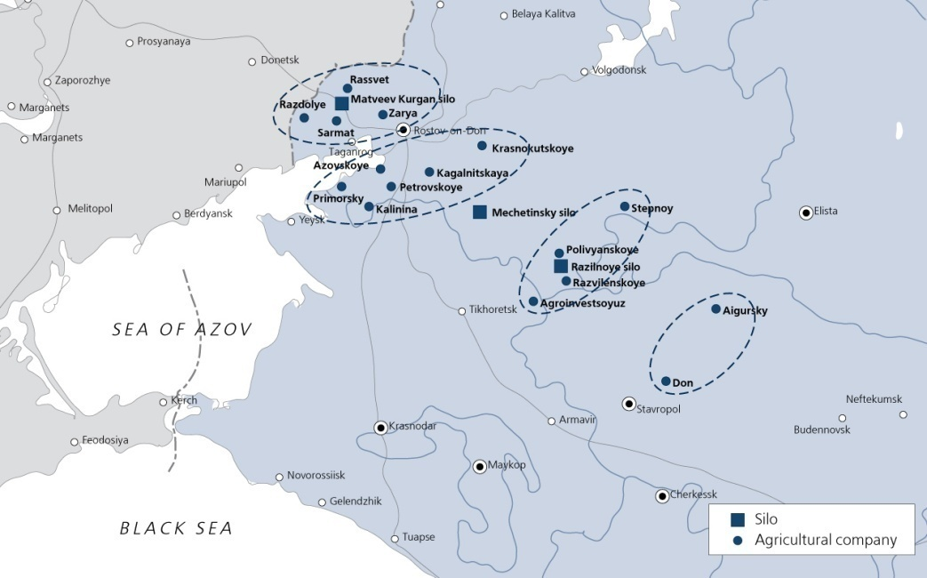
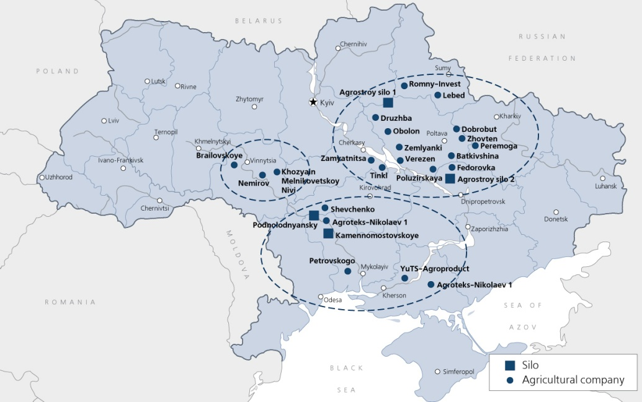
High Quality Land Bank
Land under control
Russia, map of operations
Source: Management accounts
    Land bank of 358 ths hectares, 66% in Russia and 34% in Ukraine:
      Rostov, Stavropol and Krasnodar regions in Russia
      Vinnitsa, Sumy, Poltava, Cherkasy, Mykolaiv and Kherson in Ukraine
    High quality land characterized by:
      High relative current and potentially achievable crop yields
      Favorable weather and climate conditions
      Fertile “black earth” soil
      Regional diversification
      Slight differential in harvest timing allowing for optional machinery and resource usage and cost savings
      Concentrated in seven compact clusters
      Proximity to export routes and major domestic customers
      Historically specialized agricultural regions with the availability of a skilled workforce, supplies of raw materials and relevant logistics developed over many years, as well as agro focused government support and regulatory environment
Ukraine, map of operations
    The Group’s land portfolio is located in regions with highly advantageous climate and soil conditions with high crop yields while land clusters are also close to major export routes and domestic customers
6

Slide 8

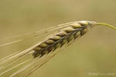


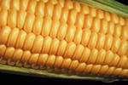
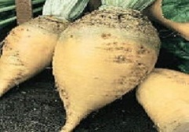
Optimal Product Mix. International Sales
Product |  | % of 2011E revenue | Major use | Domestic markets | Export markets | Seeding | Harvest-ing | Sales
 | Winter wheat | 52% | Mainly for food and livestock feed | V |  | Sep - Oct | July | Aug – Dec (70% of volume) Jan – July (30% of volume)
 | Winter barley | 3% | Mainly for the production of animal feed and for human consumption |  |  | Sep | June - July | July – Dec
 | Sunflower seed | 25% | Production of edible oils, biofuel and for animal feed |  | V | May | Sep - Oct | Oct – Feb
 | Winter rapeseed | 7% | Production of edible oils, biofuel and animal feed |  | V | Aug - Sep | July | July - Sep
 | Corn | 5% | Food, production of biofuel and animal feed | V |  | Apr | Sep - Oct | Oct – Dec
 | Sugar beet | 9% | Production of sugar, biofuel and animal feed |  |  | Apr | Sep - Oct | Sep - Oct
V
V
V
V
V
V
    As the Group announced in 2010 , in 2011 it started to export produced crops from Russia avoiding trading companies.
    Nearly 70% of produced in Russia winter wheat, 90% of sunflower seeds, 60% of corn was exported by the Group itself in 2011.
V
V
Note:
Principal Valinor sales focus - Alternative Valinor sales channel
    The Group is focused on commercially viable crops for which there is high demand and liquidity
7

Slide 9
High Operating Efficiency: Yields Drivers
High quality raw materials
Skilled employees
Category of costs: | Key suppliers:
Fertilizers (19% of total costs) | Syngenta, BASF, Bayer, Dupont, “Uralkhim”
Chemicals (8% of total costs) | BASF, Bayer and Syngenta, Dow Agro Science, DuPont, Bayer, and Arista, FMCi
Seeds (7% of total costs) | Pioneer, Syngenta, Cassad, KWS
Category | Number |  |  |  | Tonnes/employee p.a.
 | 2009 | 2010 | 2011E |  | 2009 | 2010 | 2011E
Crop production | 4,432 | 4,656 | 4,677 |  | 215 | 241 | 281
Administrative | 593 | 602 | 651 |  | 1,606 | 1,868 | 2,020
Total Valinor | 5,626 | 5,811 | 6,175 |  | 169 | 193 | 213
    Valinor increases the productivity of its employees through training and the adoption of modern farming techniques. Valinor has been able to rationalise staff numbers and concentrate on building a workforce of long term skilled workers
    Company purchases raw materials from the major international producers and achieves significant economy due to its large scale
Modern machinery
Optimized land utilization
Machinery | Dec-11
Combine harvesters | 329
Tractors | 1,059
Seeding machines | 625
Trucks and other equipment | 4,008
Total | 6,021
    Additional modern machinery and equipment for existing farms will help to improve yields, increase labor productivity and reduce repair and maintenance and other operating costs
    Farming equipment is manufactured by John Deere, Claas and CNH
    Valinor has almost no fallow land and all of its land is cultivated where this is technically possible
Source: Management accounts, Company data
    Valinor is strongly focused on continuous improvement of its crop yields and is dedicated to development of all necessary components to achieve this improvement
8

Slide 10
High Operating Efficiency: Achieved Results
Wheat yield
Sunflower seed yield
Winter rapeseed yield
Improving yields
Source: Company data, Rosstat, SovEcon, Ukrstat, Apk-Inform
Consolidated
Russia
Ukraine
Higher Gross Profit margins
Note: (1) Adjusted Gross profit does not include net change in fair value of biological assets and agricultural produce
Source: From or derived from IFRS financial statements
    Valinor consistently demonstrated above industry yields and superior profitability in Russia, where lands were cultivated with modern technology and machinery for several years. Profitability of Valinor’s operations in Ukraine increased substantially while is still lower than in Russia despite comparable soils quality mostly due to underequipment of farms
9
9
9

Slide 11
Crop Yields & Profitability Improvement at Controlled Land
Cereals average¹ yields, t/ha
Oilseeds average² yields, t/ha
Corn yields, t/ha
Yields Improvement Drivers
    Continuous application of modern farming technology for several consecutive years.
    Efficient usage of available for the Group crops storage facilities allows to preserve achieved on-field yields during harvesting.
    Gradual substitution of the existent outdated agricultural machinery with more efficient machinery produced by leading world companies (Case, New Holland, John Deer etc.).
Adj. EBITDA³ per ha harvested and margin dynamics
Profitability Improvement Drivers
    Centralization of sales allows to bargain on the most favorable conditions.
    Sufficient storage capacities allow to benefit on timely sales achieving the best quotes on the international markets.
    Economies of scale achieved by centralized purchases of raw materials, efficient logistics in usage of machinery fleet, labor expenses cut via removal of overlapping employees’ functions.
Source: Company data, Managerial accounts, IFRS statements
Note (1): Cereal average yields computed as weighted average of winter wheat, corn and barley yields weighted by area harvested
Note (2): Oilseeds average yields computed as weighted average of sunflower seeds and rapeseeds yields weighted by area harvested
Note (3): See page 3 for definition of Adjusted EBITDA
    Management believes that Valinor has already proved its ability to improve crops’ yields and efficiency of controlled land exploitation by improvement crops’ yields and margins
10
10
10

Slide 12
Advantageous Logistical Infrastructure and Storage Capacity
Location of Grain silo and Delivery ports
Grain silo and granary storage capacities
Grain silo:
Line grain silo
Type of storage | Actual annual capacity, 000’ tonnes
Group’s silos in Russia and Ukraine: | 564
- 4 silos in Russia | 451
- 3 silos in Ukraine | 114
Granaries in Russia and Ukraine (on-farm) | 713
Total Group Silo and Granaries capacities | 1,277
Moscow
Delivery ports capacities:
Kyiv
>500,000 tonnes
Yuzhniy
Odessa
>100,000 – 500,000 tonnes
Nikolaev
Taganrog
Sevastopol
<100,000 tonnes
Kerch
Eysk
Novorossiysk
Rostov-on-Don
Tuapse
Azov
    The location of Valinor’s land provides convenient access to domestic customers, key export routes and its own silos and storage facilities:
      Located within 30 to 300 kilometres from Company’s fields
      Close proximity to the key oil-producers’ facilities in both Russia and Ukraine
    Most crops are moved by truck both to customers’ facilities and to the Group’s silos. The Group has a fleet of 4,008 trucks, grain haulers and other road vehicles
    Storage capacities are buildings where the harvest can be safely stored immediately following harvesting, maintaining the quality of harvested crops and giving more flexibility in terms of the most beneficial timing for crop sales on the market
    Two types of storage capacities are used by the Group:
      Silos concentrated near the middle of land clusters are equipped with crop cleaning and drying equipment and have high-capacity crop loading and unloading systems.
      Granaries spread across the Group’s lands are used for cost-efficient on-farm storage for a period of up to one year
Source: Company data
    Sufficient capacity in its silos and warehouses for the total volume of annual crop production,
    allows Valinor to store harvested products and to sell them throughout the year at higher prices

Slide 13
Financial Overview
Revenue by countries
Gross profit
Note (1): Adjusted Gross profit does not include net change in fair value of biological assets and a
agricultural produce
Source: IFRS financial statements or derived from IFRS financial statements, Company data
Source: IFRS financial statements
EBITDA
Leverage
Source: Derived from IFRS financial statements, Company data
12
Source: IFRS financial statements or derived from IFRS financial statements, Company data

Slide 14
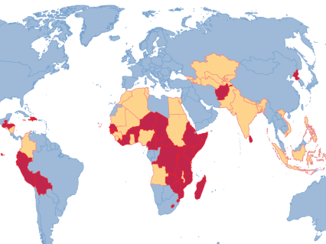
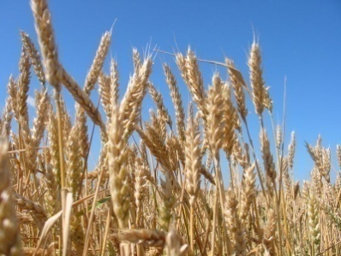
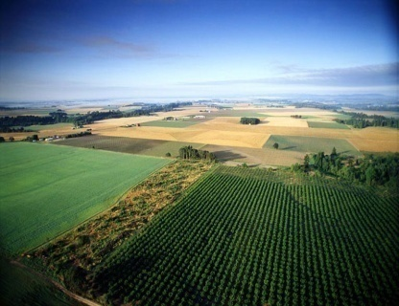

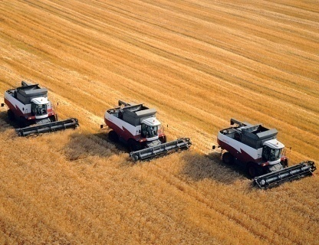
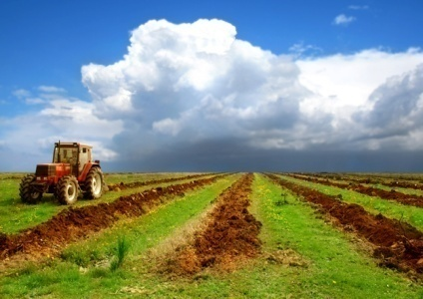
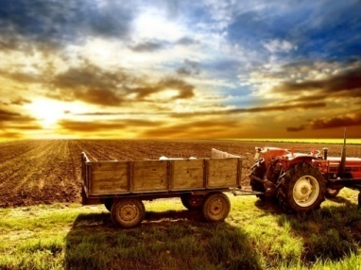

Attractive global market fundamentals
Clear focus on crop production
Favorable land bank locations
Optimal product mix
High efficiency of operations
Benefits from scale
Advantageous logistical infrastructure and storage capacity
Strong management
13

